Slide 1
Legislatures Under Stress:
Promoting and Protecting the Institution
Thad Kousser, UC San Diego
Bowhay Institute for Legislative Leadership Development, July 2026

Slide 2
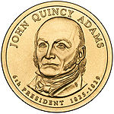
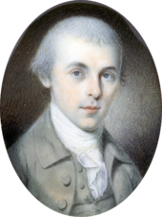
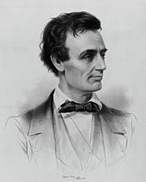
State Legislators
Not Attending the BILLD
James Madison
Abraham Lincoln

Slide 3
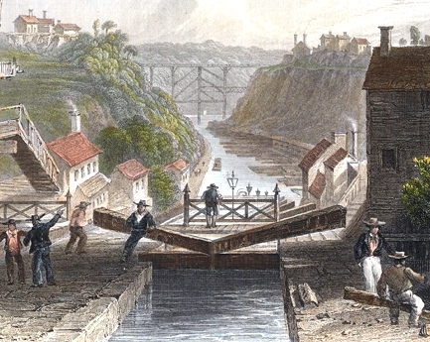
19th Century State Legislatures
Service in them was often more prestigious than serving in Congress (certainly more pleasant)
  States spent far more than the federal government
  Played key role in building early infrastructure

Slide 4
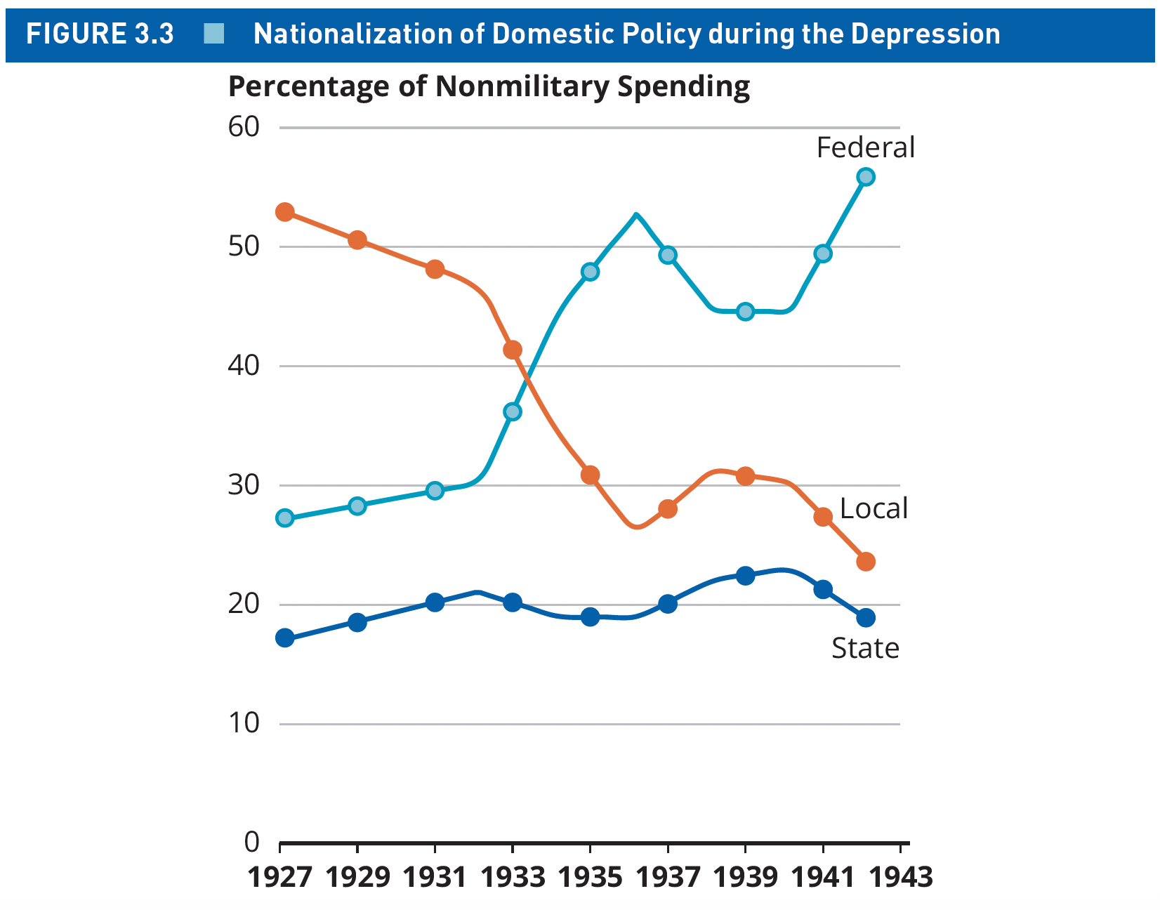
States Led First
Until the Depression, state and local governments combined spent more domestically than the federal government.

Slide 5
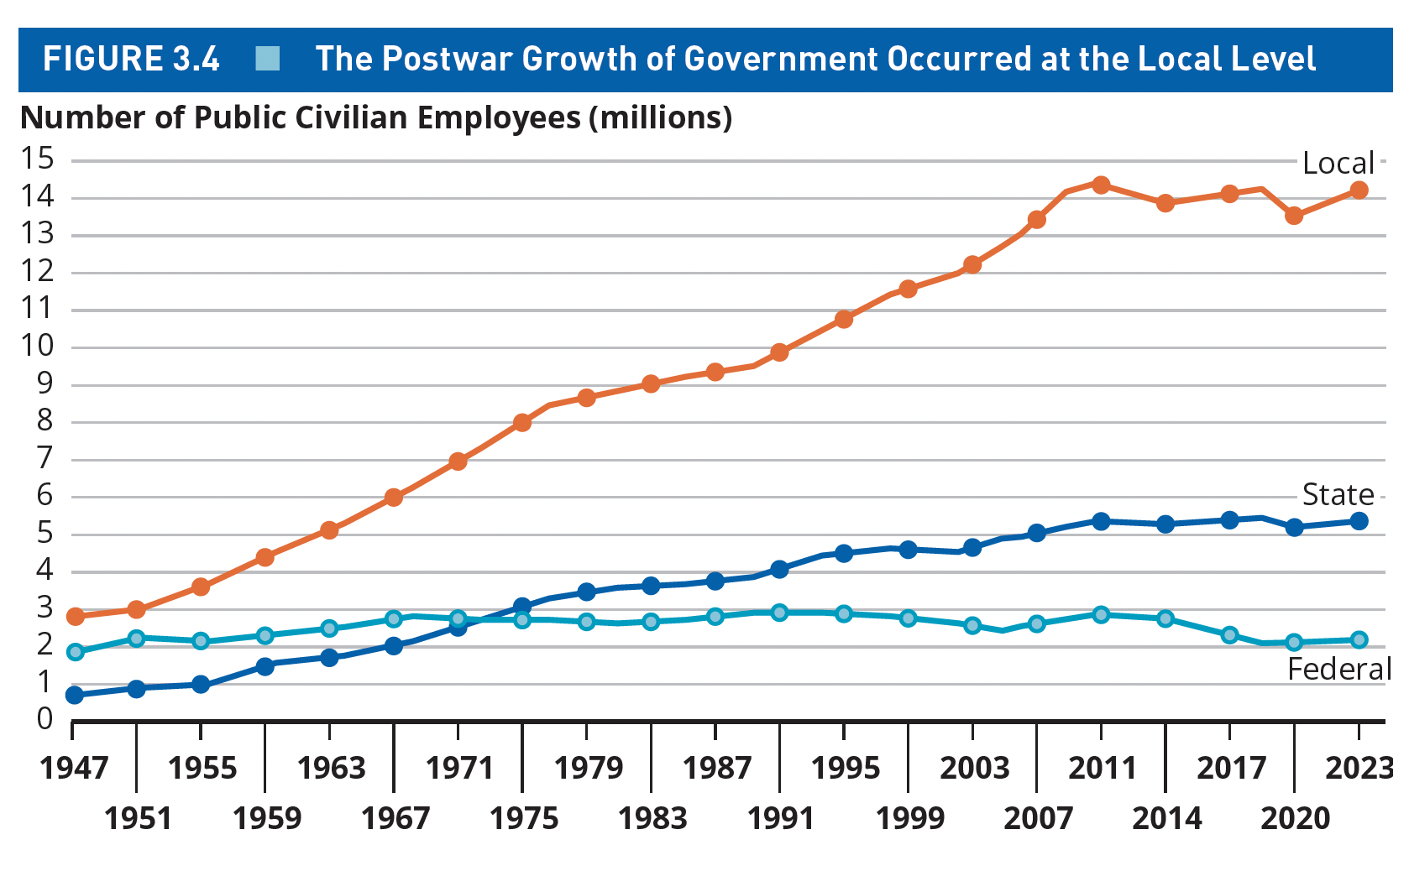
State and Locals Still Employ the People Who Serve the People

Slide 6
States as Policy Pioneers
States initiated the safety net
  Veterans benefits, retiree pensions, and funding for orphans all originated as state policies
States have been the “laboratories for reform” that spark and spread innovation
  Education
  Environmental policies
  Economic development
States are on the front lines of social controversies and don’t hesitate to take on presidents or courts

Slide 7
State Legislatures at Midcentury
“The American state legislature is in trouble….. It is very possibly true that no American political institution has ever had so many detractors, so few defenders, or such a wide array of charges leveled against it.…Today’s legislatures are located on the outskirts of public esteem and affection.”
--William Keefe

Slide 8
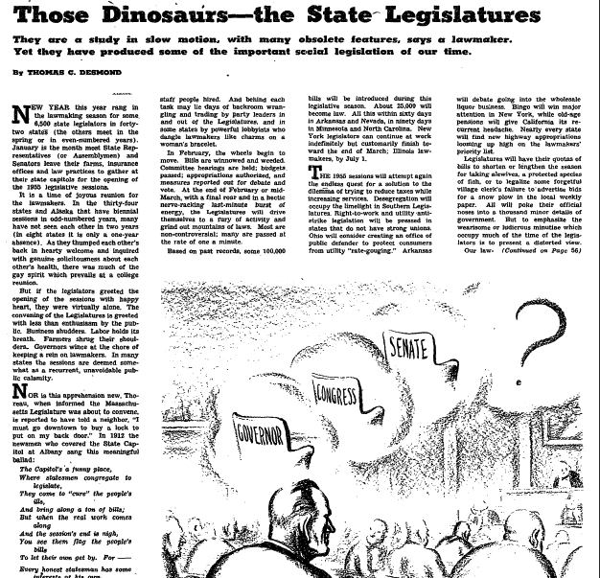

Slide 9
Trivia That Isn’t Trivial
Which legislature in the Midwest has the largest number of members (201)?
Which Midwestern legislature reduced its own size by 70% in the 1930s?
What obstacles and opportunities does a legislature’s size provide?

Slide 10
Legislative Professionalization Movement

Slide 11
Some Legislatures Changed More than Others
(session days in a biennium)

Slide 12
Evaluating the Modernization Movement
The Goals of Professionalism
  To make legislatures transformative. In contrast to a parliament that rubber stamps cabinet requests, it could change proposals and design bills of its own
  Expert staff designed to make lobbyists less powerful
  Full-time members would not be tied to the whims or special interest of a day job

Slide 13
Evaluating the Modernization Movement
Critique of Professionalism
  Power of incumbency grows with increased resources, could make government less responsive
  Special interests still wield power through campaign contributions
  “Career politicians” drawn from ranks of staff and local office

Slide 14
Voter Revolt of the 1990s: Term Limits
 | Year of Impact | Year Enacted | House Limit | Senate Limit | Lifetime Limit or Consecutive
California | 1996 | 1990 | 12 (c) | 12 (c) | Lifetime
Maine | 1996 | 1993 | 8 | 8 | Consecutive
Colorado | 1998 | 1990 | 8 | 8 | Consecutive
Arkansas | 1998 | 1992 | 16 (c) | 16 (c) | Consecutive
Michigan | 1998 | 1992 | 12 | 12 | Lifetime
Florida | 2000 | 1992 | 8 | 8 | Consecutive
Ohio | 2000 | 1992 | 8 | 8 | Consecutive
South Dakota | 2000 | 1992 | 8 | 8 | Consecutive
Montana | 2000 | 1992 | 8 | 8 | Consecutive
Arizona | 2000 | 1992 | 8 | 8 | Consecutive
Missouri | 2002 | 1992 | 8 | 8 | Lifetime
Oklahoma | 2004 | 1990 | 12 (c) | 12 (c) | Lifetime
Nebraska | 2006 | 2000 |  | 8 | Consecutive
Louisiana | 2007 | 1995 | 12 | 12 | Consecutive
Nevada | 2010 | 1996 | 12 | 12 | Lifetime
North Dakota | 2022 | 2022 | 8 | 8 | Lifetime

Slide 16
Limits & Who Goes to State Capitols?
Gender and Demographic Diversity
Gender
Race and Ethnicity
Despite great expectations, term limits has not led to a substantial increase in the number of women in state legislatures
Women gained more seats in states without term limits than in states with limits from 1991 to 2009
Stable minority populations, like Black Americans, do not appear to benefit
Groups with growing populations win a few more seats as term limits opens them up (Latino and AAPI)
Leadership opportunities open up within houses

Slide 17
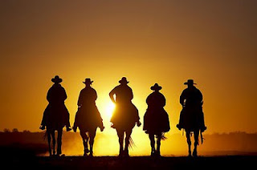
Limits & Who Goes to State Capitols?
Citizen vs. Professional Politicians
The Hope: LIMITS (Let Incumbents Mosey Into the Sunset)

Slide 18
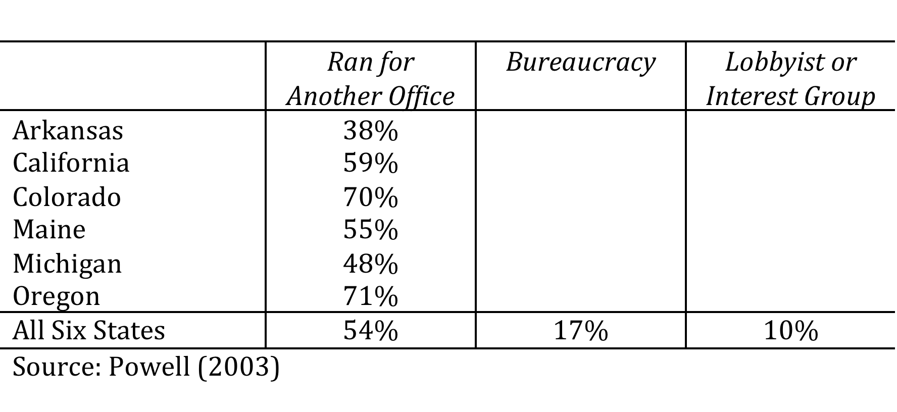
Limits & Who Goes to State Capitols?
Citizen vs. Professional Politicians
The Reality: Political animals don’t change their stripes

Slide 19
What Is the Sum of Term Limit Changes?
Areas of Stability
Areas of Change
Makeup of legislatures and career ambitions of legislators
Influence of lobbyists
Electoral competition
Scope of legislation
Experience and expertise
Balance of power with executive branch
Trustee vs. delegate
Innovation and spending

Slide 20
Trivia That Isn’t Trivial
Which state’s Joint Committee on Finance is arguably the most powerful state legislative committee in the nation, empowered to:
  Craft the legislative budget
  Hear all revenue and spending bills
  Supplement agency appropriations
  Transfer funds between programs
  Adjust staff positions at agencies

Slide 21
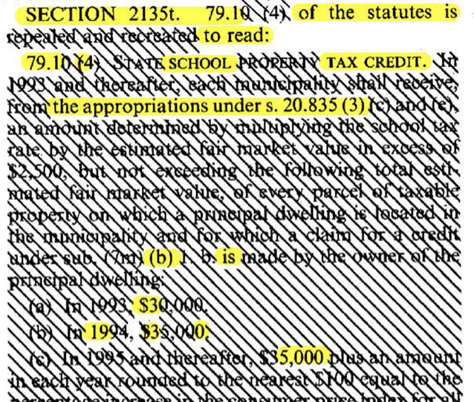

Bonus Question: Explain that state’s “Vanna White Veto”

Slide 22
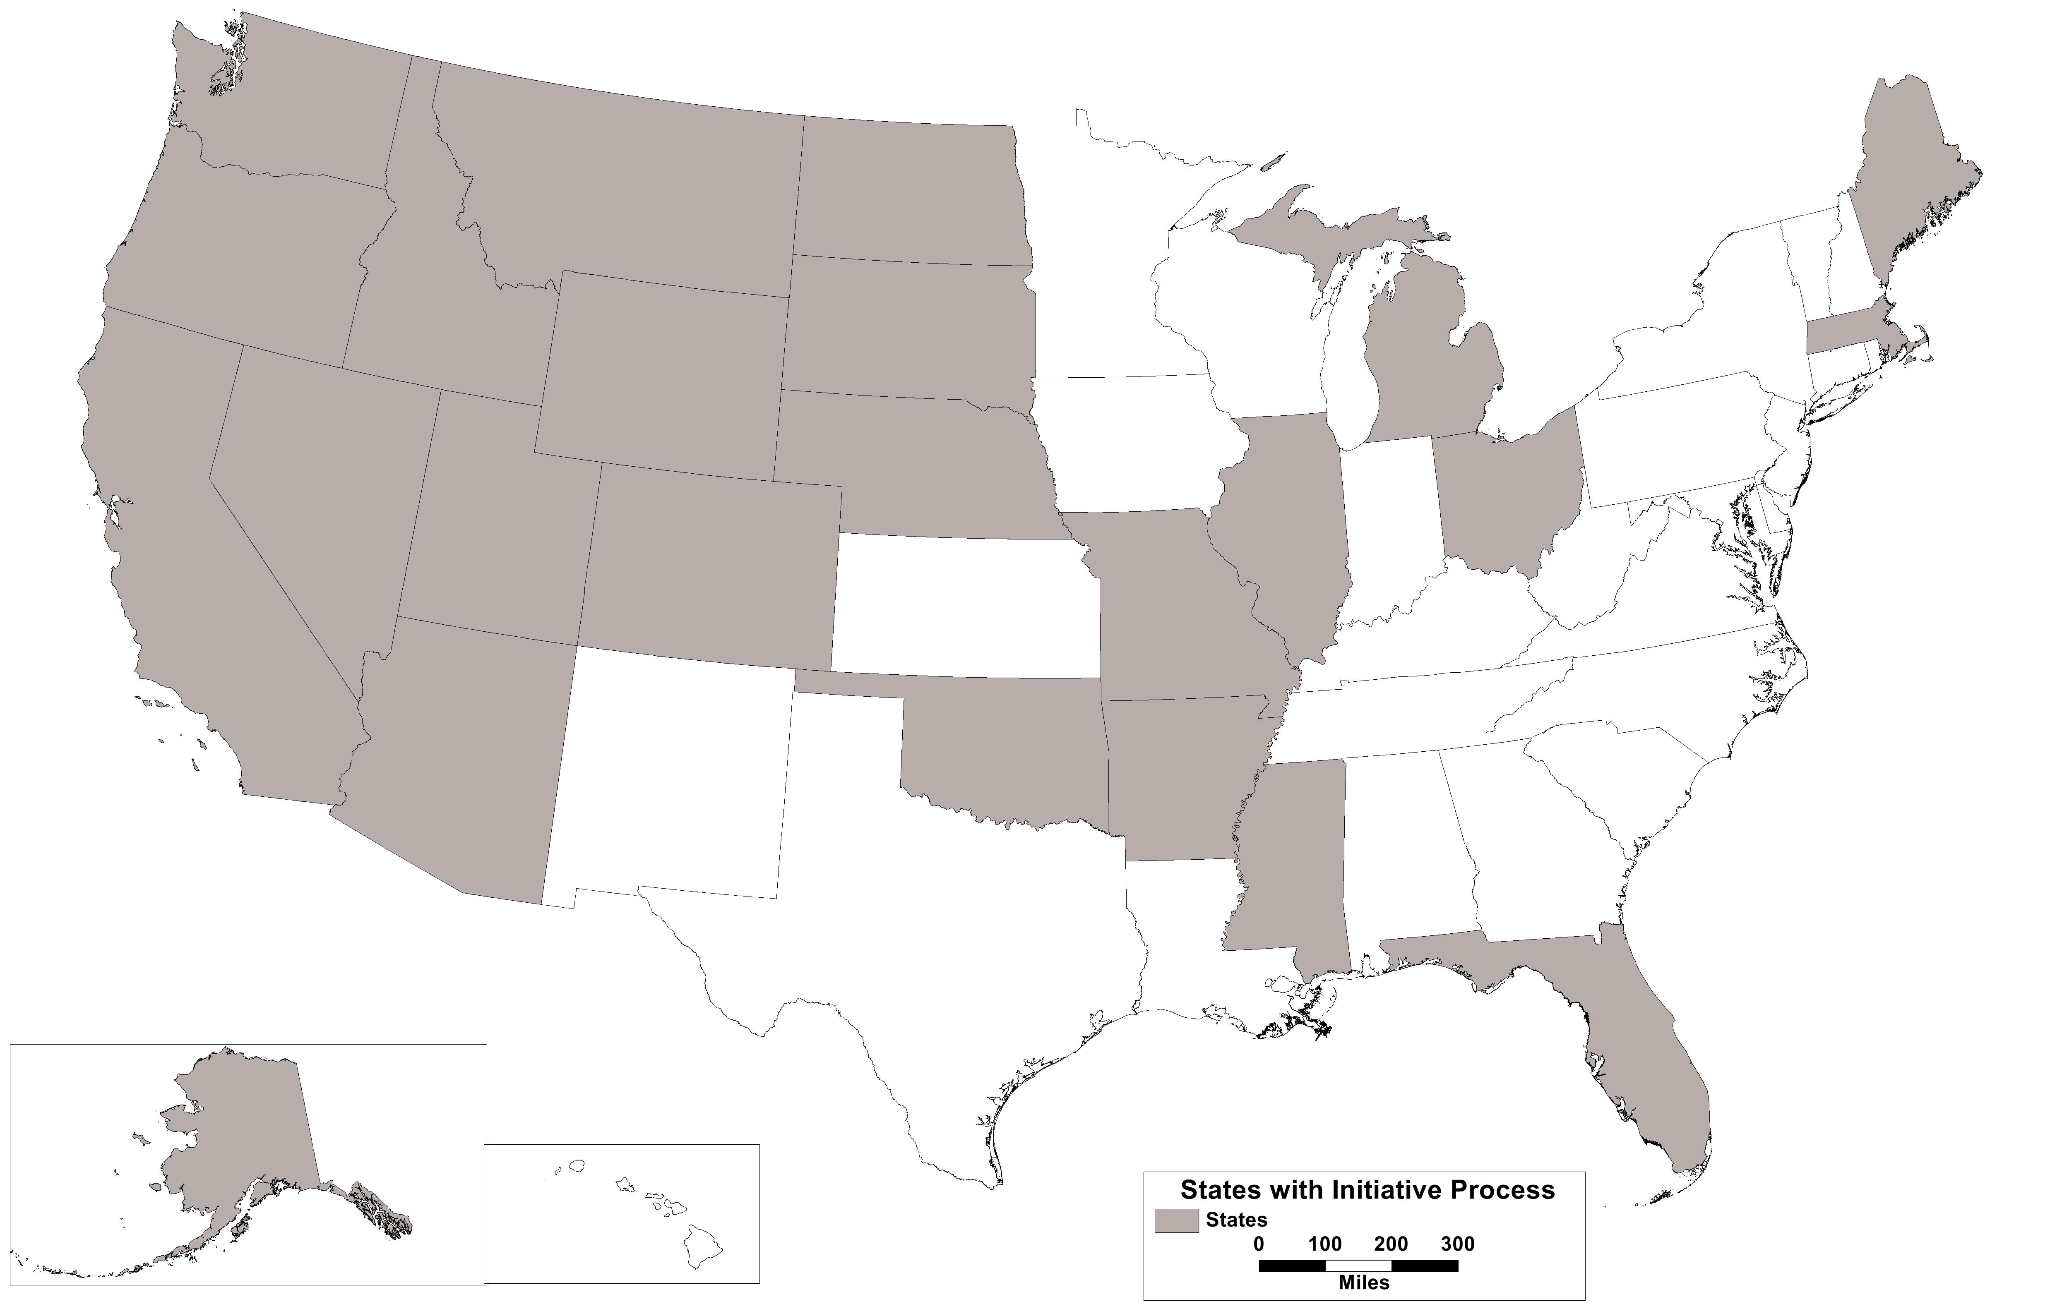
Progressive Revolt of 1898-1918:
Establishing the Initiative Process

Slide 23
The “Hybrid Democracies” of the States
Direct Democracy
Representative Democracy
Citizens can pass news laws and constitutional amendments (initiative)
Power to overturn what the legislature passes (referendum)
Elected officials act as agents of citizens, have first opportunity to make policy
Elected officials entrusted with implementing initiatives

Slide 24
Some Midwestern States Make Frequent Use of the Initiative Process…

Slide 25
…Now More than Ever

Slide 26
What Does This Mean for Your Job?
As critical issues are decided at the ballot box, legislatures become less central to state policy
Voters have used direct democracy to constrain the choices that legislators can make
  Tax and expenditure limits, supermajority requirements
  Ballot box budgeting
Legislatures can duck tough issues by sending them to the people, trading short term electoral gain for long term institutional loss

Slide 27
Trivia That Isn’t Trivial
Which legislators in the Midwest represent the largest number of constituents (nearly 350,000)?
How many constituents live in your district?
  What strategies do you use to communicate with them effectively and to learn about their diverse opinions and needs?

Slide 28
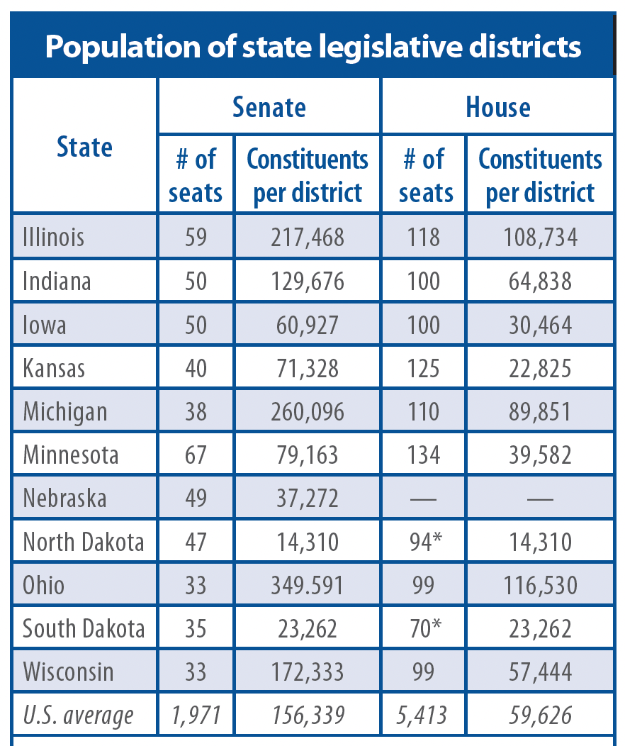
State Legislatures Today:
Growth in District Size

Slide 29
State Legislatures Today:
Costly to Compete

Slide 30
State Legislatures Today:
Partisan Polarization

Slide 31
State Legislatures Today:
Partisan Polarization
Studies of voting patterns show more polarization than there has been in a century
  Arranged on an ideological spectrum, party caucuses have moved farther away from each other
  This reflects a trend among voters as well
Deals are harder to reach when the ideological gap between parties becomes a chasm
Civility can suffer, but that is not predestined

Slide 32
State Legislatures Today:
What the Public Thinks
“NAIL DOWN or hide your valuables, folks. More than 1,500 politicians from around the country are in Anchorage for a national gathering of state leaders”
--Anchorage Daily News, during CSG’s Annual Meeting

Slide 33
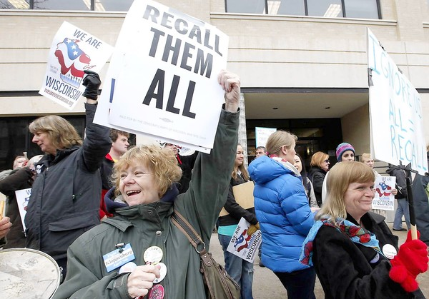

Slide 34
State Legislators and Social Media
67% of state legislators have a public X handle, producing 3,580,727 tweets (averaging about 1100 per tweeting lawmaker)
They tweet about everything from their policy stances to their dogs, seeking to gain trust and connect with constituents
When they tweet about ideological positions, it is generally truth in advertising

Slide 36
Ideal of How a Statehouse Works
Deep Societal Divisions
Intense Fiscal Stress
Agreements That Endure

Slide 37
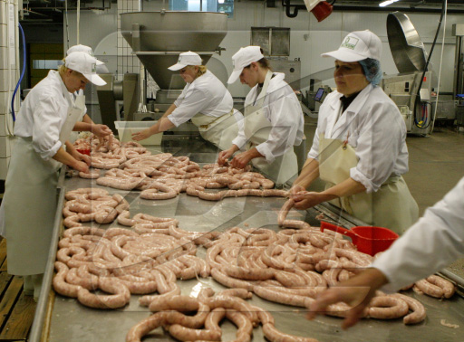
How Voters Think a Statehouse Works

Slide 38
Final Thoughts
Serving in state legislatures has always been a hard, but crucially important, job
  Perhaps more demanding and crucial than ever
States invested much in these institutions over the last generation, but also placed limits on them
  Term limits and increasing use of initiatives
Individual incentives are centrifugal forces, but legislators must come together to aid institutions

