Slide 1
Getting the Job Done:
Process and politics in the midwestern state legislature
Thad Kousser, UC San Diego
Bowhay Institute for Legislative Leadership Development, July 2026

Slide 2
Trivia That Isn’t Trivial
Which Midwestern legislature guarantees that every bill gets a hearing a committee and then a vote on the floor, and makes caucus meetings open to the public

Slide 3
Discussion Breakout #1:
What Shapes How Your Institution Works?
If you had to pick one rule – a constitutional provision or chamber rule – that characterizes how your legislature operates, what would it be?
or
What is one norm – a practice, not formally required but followed based on consensus or history – that exemplifies how your state does things?

Slide 4
Discussion Breakout #2:
How Will You Build Your Institution?
From your experience or from what you have learned today, what is a rule or your norm that you would consider changing in your chamber?
  Reforming an existing rule?
  Importing and adapting an idea from another state?
  Changing one aspect of the culture?

Slide 5
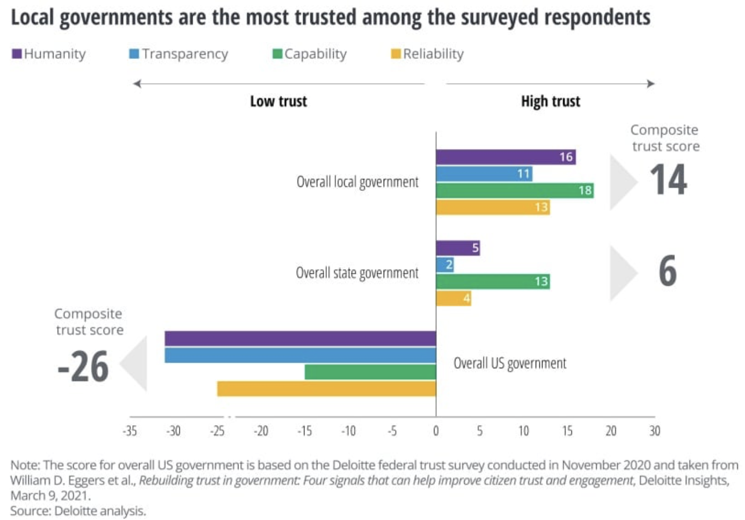
Building Trust Within Your Institution
And With Your Voters

Slide 6
Building Trust Within Your Institution
And With Your Voters
Institution. When legislators take part in “public goods games,” trust and cooperation is highest when information is shared equitably across players.
Voters. Cooperative randomized studies show that when state legislators let voters know about positions that constituents disagree with:
  Voters are more likely to adopt these positions, and
  More likely to approve of their legislators

Slide 7
Discussion Breakout #3:
How Will You Protect Your Institution?
How do you build trust with your constituents and trust in the institution, especially when you have to deliver bad news?
  What approaches do you adopt when you talk with constituents and groups that are unlikely to agree with you, in our polarized era?
  or
  How do you talk about the state legislature to your constituents, especially when as an individual you do not agree with collective decisions?

