Slide 1
Understanding Your
Communication Style:
Having a Positive Impact
on Others
BILLD Conference
July 18, 2026
Facilitated by Lori Gibson
LK Gibson Consulting

Slide 2
Self Awareness
Social Awareness
Social Skill
Application
Understanding yourself - your strengths, weaknesses, potential blind spots, and drivers
Develop your personal capability and effectiveness as a legislator/leader by the way in which you interact with others, build consensus, manage conflict, and communicate decisions.
Understanding others and what drives them
Understanding the impact you have, how to adapt to and influence others

Slide 3
Our Objectives for Using the DISC Assessment
Identify the strengths of your behavioral style and how to leverage those in your relationships and communication with constituents.
Identify the elements of your behavioral style that could create barriers to your success and how to overcome or compensate for them.
Plan ways in which you can adapt your approach to be more effective with specific people that you find challenging.

Slide 4
What DISC Measures
What drives or motivates us
What we're passionate about
What our natural perspective on things is (i.e. the perspective through which we see our own behavior and the behavior of others)
Our priorities and focus
Our approach to tasks like decision making, managing conflict, leading others, and our reactions under stress
The potential impact of our behavior

Slide 5
What DISC Does NOT Do
Measure intelligence, values or beliefs
Judge right or wrong
Measure education, skills or experience
Intend to be subjective or judgmental, rather objective and observable
Imply that one style is better than another or that there is any correlation between style and the likelihood of success

Slide 6
What Drives Us?
Outgoing
Reserved

Slide 7
What’s Our Compass?
Task Oriented
People Oriented

Slide 8
Putting it all Together
Outgoing
D
I
Task Oriented
People Oriented
C
S
Reserved

Slide 9
Recognizing a Strong D
Leads with… | Tenacity, Drive, Energy
Expects people to… | Accept responsibility, Do "whatever it takes" Get results, Take action
Operating from strengths, they… | Confront issues effectively, Complete enormous amounts of work, Focus on goals, Make things happen
Potential blind spots… | Keeping too much control, Deciding before getting enough facts or input, Ignoring relationship issues, Moving quickly before others are “on board”

Slide 10
Recognizing a Strong I
Leads with… | Inspiration, Enthusiasm, Optimism, Humor
Expects people to… | Relax and lighten up (not take themselves too seriously), Figure things out, Be flexible
Operating from strengths, they… | Provide inspiration, Encourage people, Help people see a better future, Bring new ideas and fresh approaches, Lighten tense situations,
Potential blind spots… | Focus on ideas rather than follow through, Being (or appearing) disorganized, Lacking direction

Slide 11
Recognizing a Strong S
Leads with… | Encouragement, Support, Affirmation
Expects people to… | Be nice to one another, Be helpful, Support the team
Operating from strengths, they… | Build strong relationships, Help people resolve conflicts, Create a warm, inviting environment, Support other people, Keep in touch with how people are feeling
Potential blind spots… | Avoiding conflict, Being indecisive - fear of consequences for a wrong decision, Becoming overwhelmed then shutting down or withdrawing

Slide 12
Recognizing a Strong C
Leads with… | Rules, Procedures, Guidelines, Process and detail orientation
Expects people to… | Focus, Follow the rules, Be logical Do what's right
Operating from strengths, they… | Are very analytical, Notice what can go wrong before it does, Think logically, See the details, Listen before they speak
Potential blind spots… | Ignoring people or relationship issues, Procrastinating on taking action, Being too much a perfectionist

Slide 13
Four Ways to Lead
Out front
Vision
D
I
In the mix
Inspiration
S
Support
Teamwork
C
Side by Side
Process

Slide 14
Learning from Other Styles
Review the page on your style’s leadership characteristics and prepare a summary for the rest of the group.
What are some ways others can adapt to your style? Please identify specific behaviors, words, or actions that would be most effective with your style.
What would be the perfect mascot and/or motto for your style?

Slide 15
Keys to Adapting for Greater Effectiveness
Diagnosis: Recognize or predict the need to alter communication behavior.
Flexibility: Are you willing to adapt? Are you sending the right messages? Is your intent clear?
Partnering: Talk with the other person about your different communication needs and how you can work best together. Demonstrate a willingness to listen and collaborate.
Note – the terms Diagnosis, Flexibility and Partnering are borrowed from Ken Blanchard’s Situational Leadership model

Slide 16
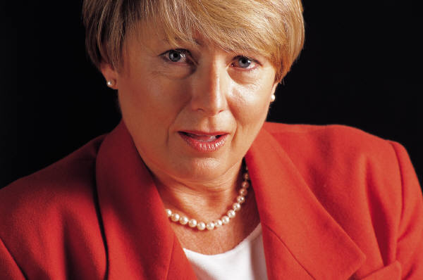
Adapting to a High D
Get down to business
Be prepared for meetings
Talk about facts, results, not personal feelings - be candid
Be clear on goals, time expectations, desired results
Provide alternative actions with brief supporting analyses to influence decisions
Be precise, efficient, and well-organized
Above all, be efficient and competent

Slide 17

Adapting to a High I
Be willing to listen to their opinions, ideas, and dreams
Allow time for brainstorming
Be flexible as priorities may change if a new and better idea comes up
Summarize in writing who is to do what, where, and when
Share some of your personal side - allow them to get to know you
Above all, be willing to engage

Slide 18
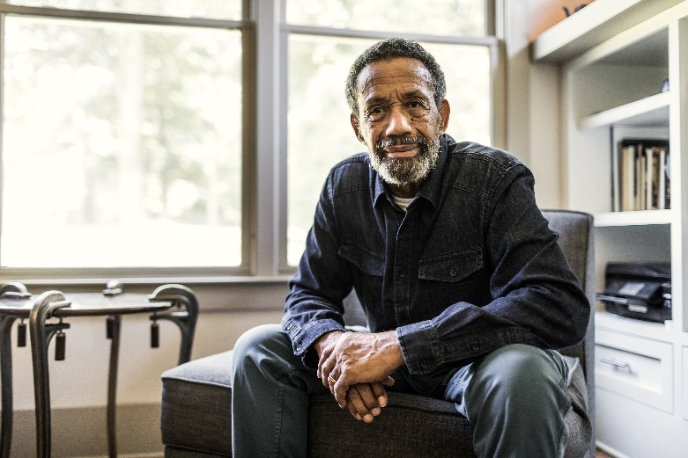
Adapting to a High S
Support them by showing personal interest
Allow them time to trust you - don't "bulldoze"
Draw them into conversations with open-ended questions
Take advantage of their focus on the human impact of decisions/actions
Take time to talk through the impact and risks
involved when decisions are made
Above all, be warm & sincere

Slide 19
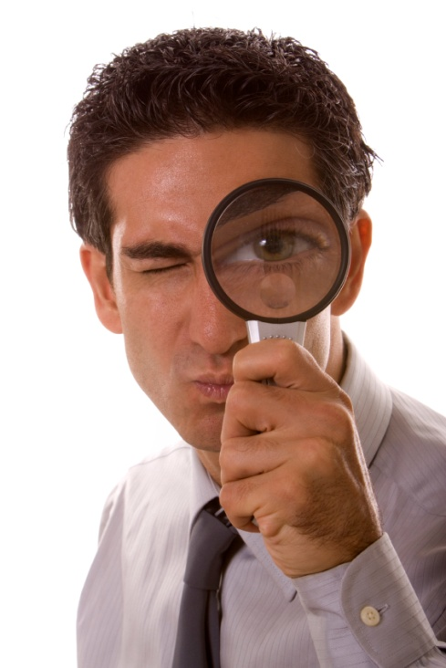
Adapting to a High C
Take advantage of their organized, thoughtful approach
Agree on specific action steps and be sure to follow through
Be organized and well-prepared for meetings
List the advantages and disadvantages of any plan
Provide solid, tangible, factual evidence
Above all, be thorough & well prepared

Slide 20
D
Don't push
I
Be more organized
S
Speak up
C
Share details if asked
Give people time to process
Slow down
Use "softer" tones
Stay focused
Know when to be serious
Show your confidence
Address conflict
Smile more - share a little of your personal side

Slide 21
How Can You Adapt?
Determine the style of a person with whom you have difficulty communicating.
What does this person do that frustrates you or creates communication difficulties?
Are there style-related differences that would promote this response?
What can you do to adapt to this person’s communication style and attempt to improve the relationship?

Slide 22
Summary Reflection
In my current role, my style works well for me in the following ways:
I need to be aware of style differences in the following situations:
In those situations, things I can do to be more effective include:

