Slide 1

Legislation and the Judiciary:
How Courts Interpret The Law.
Midwestern Legislative Conference BILLD Program – July, 2026
Robert R. Cupp
Former Justice, Supreme Court of Ohio
© Robert R. Cupp, 2026. All rights reserved.

Slide 2
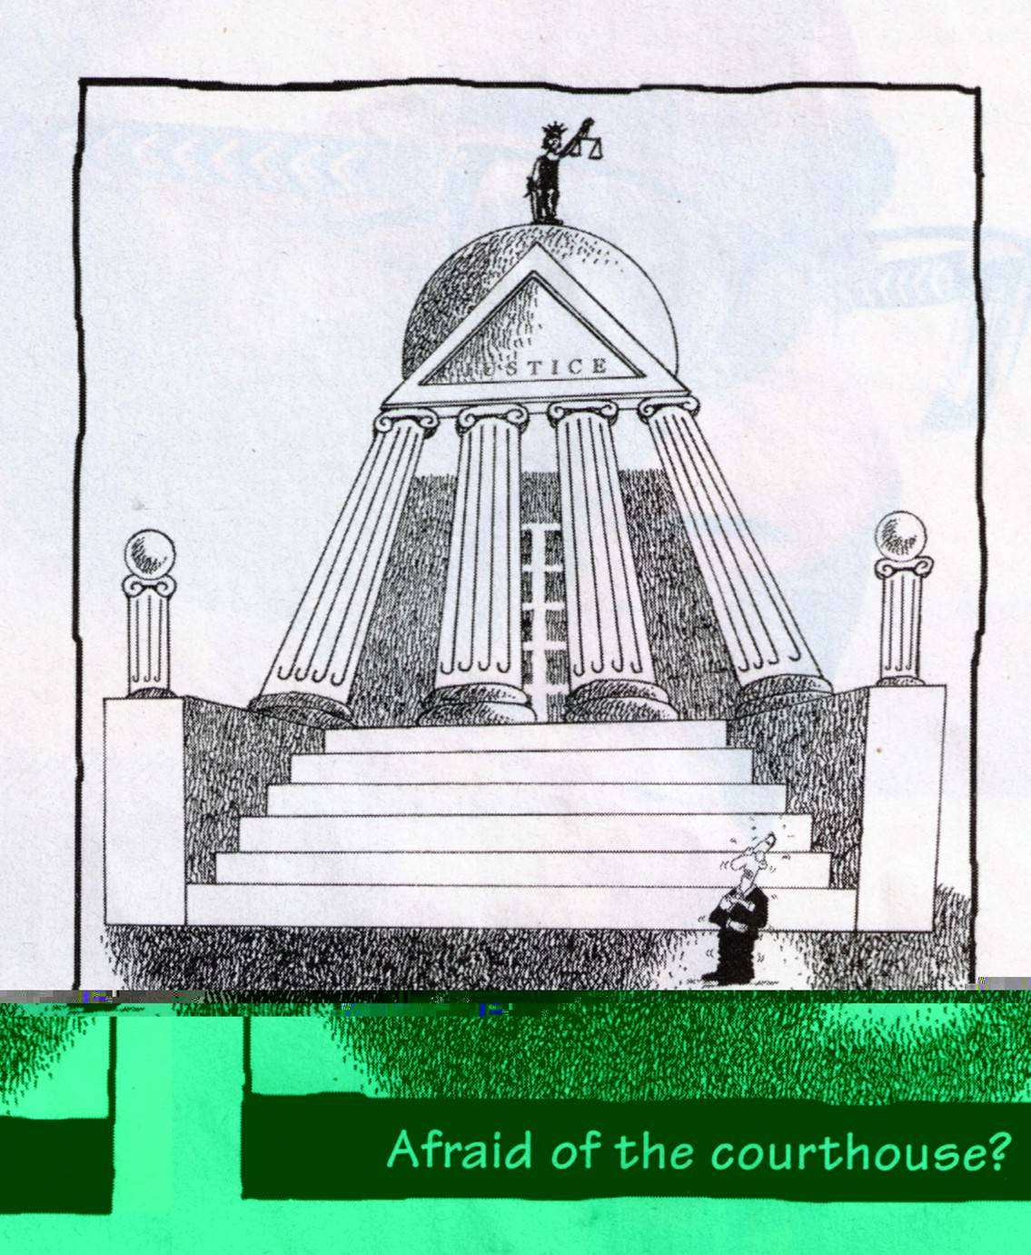
Puzzled by the courthouse?

Slide 3
Goals of Presentation
Gain better understanding of –
  Key differences between legislative and judicial processes;
  How judges decide cases when statutes must be interpreted;
  How legislators can improve the “court-decision process” through the “law-making process.”

Slide 4
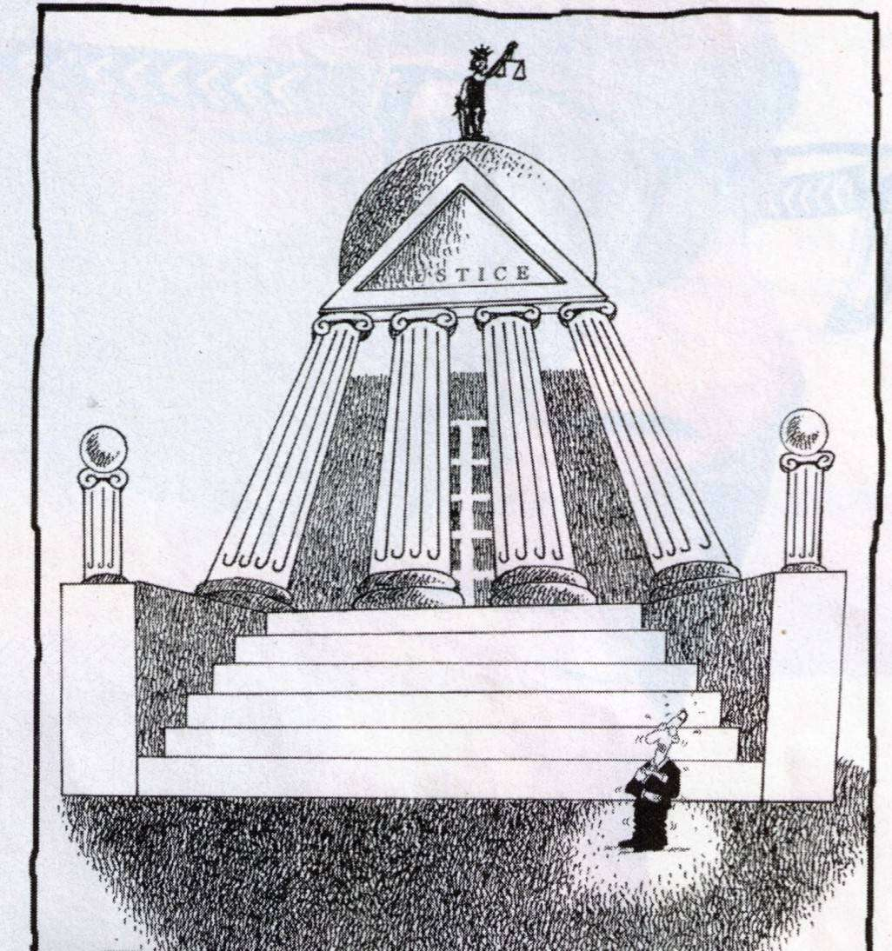

Result -
More understanding.
Less confusion.

Slide 5
Query
Which do you think is more mysterious to the public:
  the functioning of the legislature, or
  the functioning of the judiciary?
  Why?

Slide 6


Hmm. What are you?

Slide 7
A Judge’s View
“The problem is ... that the judiciary has to rationalize policy-makers' work, and fit it all together in a consistent manner. It is the quality that sticks in our craw -the often vague and discordant way in which the statutes appear in cases before the courts.”
-- ABNER MIKVA
Retired Federal Judge.

Slide 8

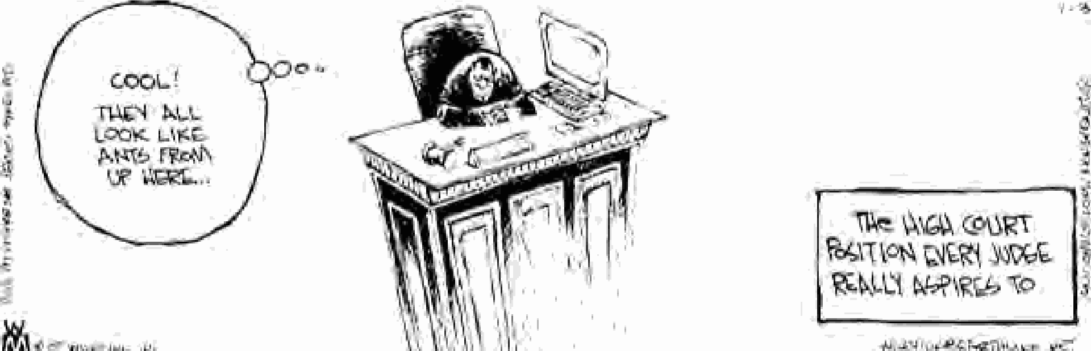
How Legislators Think Judges View Themselves?
Cool!
I AM the Judge!
They all look like ants from up here!
The High Court Position Every Judge Really Aspires to

Slide 9
Cause Of The Problem.
“The problem as often as not is the unawareness that the legislative branch and the judicial branch have of each other's game rules.”
ABNER MIKVA
Former Congressman and Federal Judge.

Slide 10
QUIZ
Do you agree or disagree with each of the following statements?
Judges often misinterpret a statute’s intended meaning.
Legislators sometimes deliberately use ambiguous language in writing a statute.
Statutes are easier to understand and interpret than case law.

Slide 11
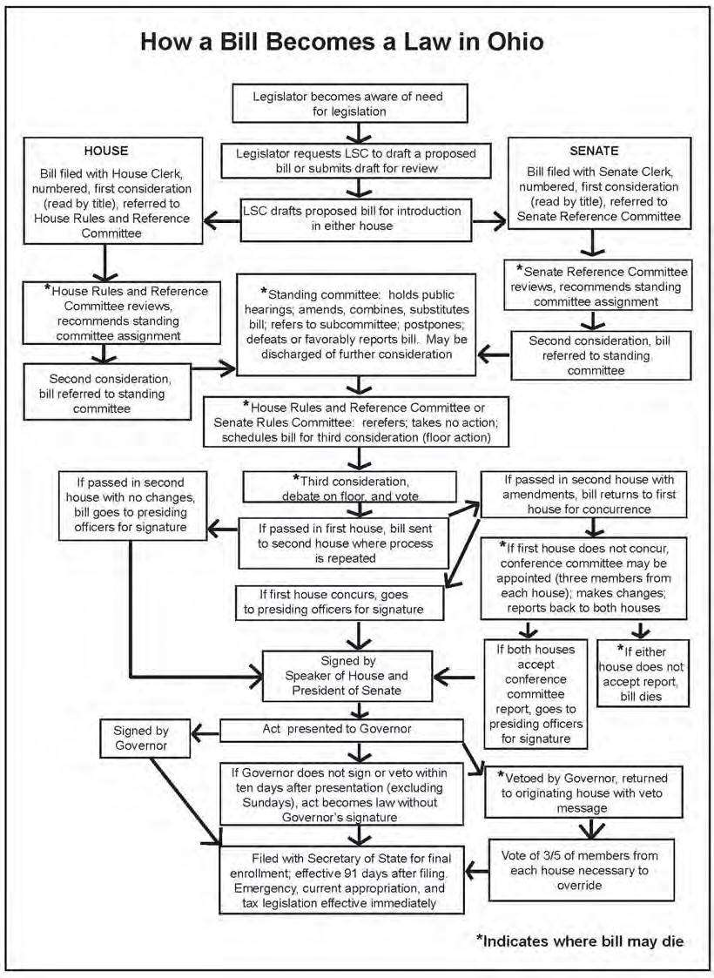

Slide 12
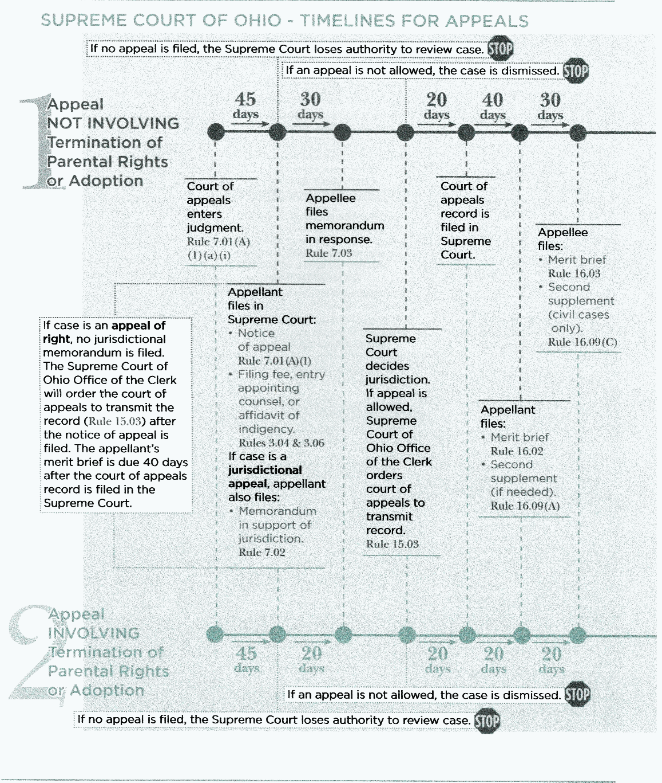
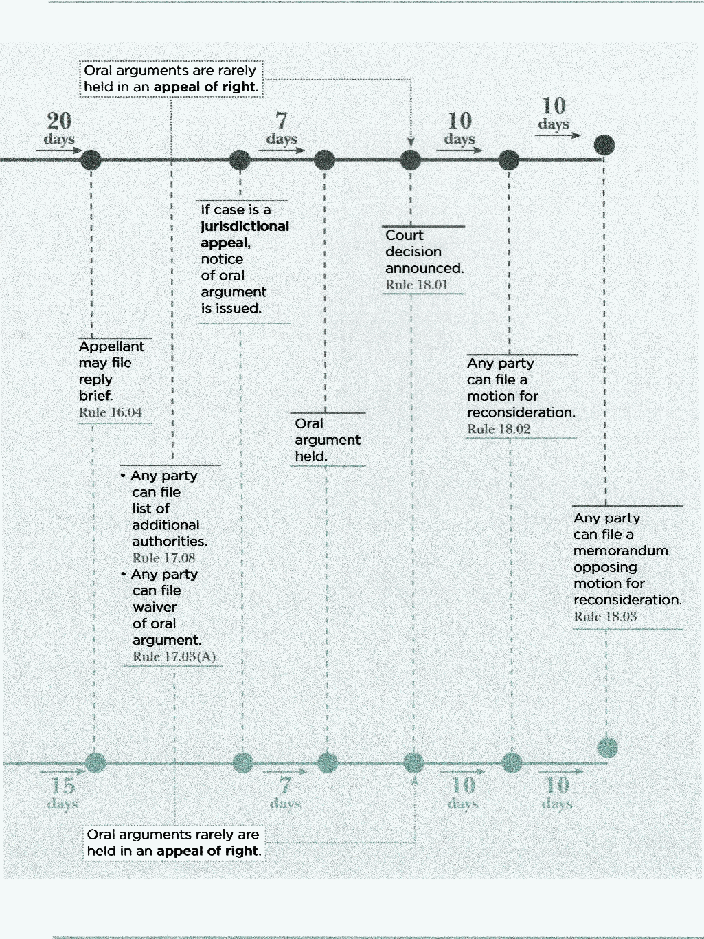
Timelines for Court Appeals

Slide 13
STATUTE
“No person shall bring a pet into a state park. Violation of this statute shall be a fine of up to $50”.

Slide 14
STATUTE
“No person shall bring a pet into a state park. Violation of this statute shall be a fine up to $50”.
The statute does not define “pet.” Is a fish a “pet”? This ambiguity could be eliminated if the statute defined “pet”.

Slide 15


STATUTE
“No person shall bring a pet into a state park. Violation of this statute shall be a fine up to $50”.
Is this what the legislature intended by using the word “pet?” Should a court interpret the term “pet” to only mean these types of pets?

Slide 16
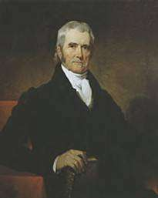
Statutory Interpretation
Primary goal:
“give effect to the will of the legislature.”
--U.S. Chief Justice John Marshall

Slide 17
Interpretation Problems
Ambiguous
Provisions Conflict
Gaps - incomplete provisions or directions.

Slide 18















Case Discussion

Slide 19



Slide 20
Points to Know
Case #1, Burg. Vs. Zimmerman
Ordinary Usage of Words
The words and phrases of a statute are to be read in context, according to the usual rules of grammar, and given their common meaning.
  Exception: if by legislative definition or otherwise the words and phrases have acquired a technical or particular meaning, then a court will apply the technical or particular meaning
Plain Meaning.
A statute is applied according to its plain meaning IF the language of the statute is plain and unambiguous and conveys a clear and definite meaning. In such situations, a court will not utilize the rules of statutory constructions.

Slide 21
Points to Know
Case #1, Burg. Vs. Zimmerman, cont‘d.
Practical pointer:
If you, as a legislator, don’t understand what a particular phrase or provision in a bill means, then a court is not going to understand it either if it comes before the court in a case or controversy.
  Nevertheless, a court is still required to make a decision in the case.

Slide 22



Slide 23

4511.01 Traffic Laws - Operation of Motor Vehicles Definitions.
“As used in this chapter *** of the Revised Code: * * * (HHH) “Operate” means to cause or have caused movement of a vehicle . . . .”

Slide 24

Following the court decision, the legislature enacted a new offense of “physical control”.
“No person shall be in physical control of a vehicle if, at the time of the physical control, the person is under the influence of alcohol....”
“Physical control” means being in the driver’s position of the front seat of a vehicle ... and having possession of the vehicle’s ... ignition key or other ignition device.”

Slide 25
Points to Know
Case #2, State vs. Cleary
The decision of the court in this case is an example of applying a broader interpretation to a statute in order to effectuate a legislative policy goal.
When a court considers legislative intent, it is gathered from the words of the statute itself.
If the legislature does not agree with the interpretation of a statute given to it by a court decision, then the legislature can amend the statute to effectuate the legislature’s preference going forward.

Slide 26
Query
What are some of the significant differences in each institution’s “rules of the game”?

Slide 27

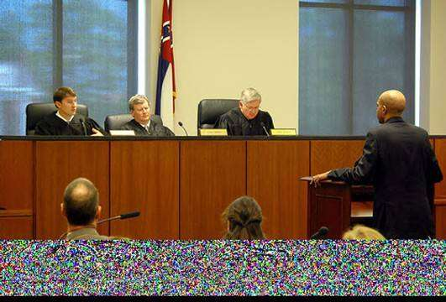
slatu
Judiciary
Legislature
Dispute Resolution
Policy-Making

Slide 28
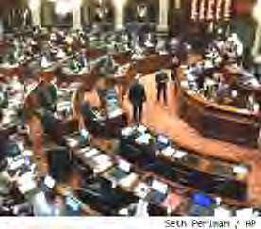
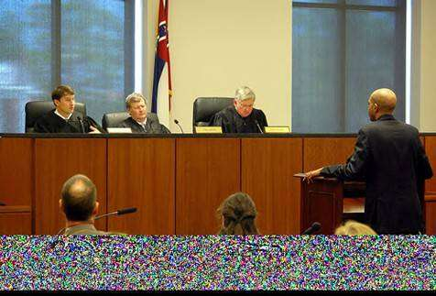
slatu
Legislature
-- Pro-active
Judiciary
-- Re-active

Slide 29

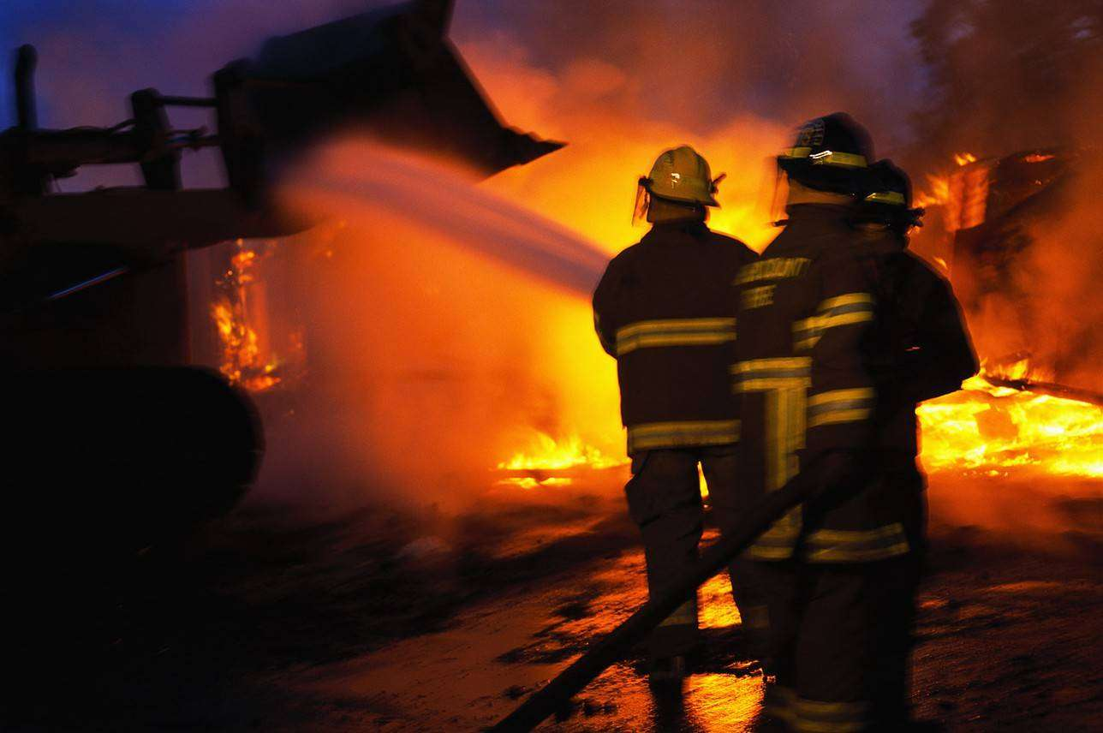

Slide 30
Points to Know
Case #3, Seider vs. O’Connell
Because an administrative agency has special expertise --
a court will usually give some deference to the agency’s interpretation of a statute if the Legislature has delegated authority to the agency to implement and enforce the statute.
However, court will not defer to the agency’s interpretation if the agency fails to apply the plain language of the statute or if the agency’s interpretation is unreasonable.

Slide 31
Sources of Law
Hierarchical order
Constitutional Law - fundamental or higher law.
Statutory Law - legislative enactments. (including political subdivisions).
Administrative Law - rules and regulations made by administrative agencies.
Common Law – judge-made law.

Slide 32
Institutional Differences
Query:
How do legislators get the information needed to draft or vote on a bill or amendment?

Slide 33
Institutional Differences
Query:
How do judges get the information needed to decide a case?

Slide 34
Institutional Differences
A judge has limited information
  Only evidence in record can be considered; and, only information comporting with legal rules of evidence can be admitted to the record.
  No outside communications or investigation.
  No “ex-parte communications,” i.e. discussions with only one party to case.
  Little or no “legislative history” to explain the intent of the legislature.

Slide 35
Institutional Differences
Result: courts must interpret statutes with provisions that are a ambiguous, conflicting, or incomplete without the information that the legislature had when it enacted the statute.

Slide 36

Statute:
“No person, eighteen years of age or
older, shall engage in sexual conduct with another, not the spouse of the offender, when the offender knows such other person is over twelve but not over fifteen years of age ....”

Slide 37

After the court decision, the legislature clarified the statutory language by making these changes:
Minimum age Maximum age
Original wording | “over twelve” years | “not over 15 years”
Amended wording | “thirteen years” or older | “Less than 16 years”

Slide 38
Points to Know
Case #4, State vs. Maxon
Criminal statutes are to be construed strictly against the state and liberally in favor of the defendant. This rule of strict construction is sometimes known as the “rule of lenity.”
A legislature can over-rule a court’s interpretation of a statute by enacting a change to the statute . . . unless the decision of the court is based on the state or federal constitution.

Slide 39
Points to Know
Case #4, State vs. Maxon, cont’d.
A legislature is presumed to have knowledge of existing court decisions when enacting or revising statutes.
Failure to act after a court ruling implies that the court decision was a correct interpretation of statute.

Slide 40


slatu
Judiciary – mandatory decision-making
Legislature – permissive decision-making

Slide 41

STATUTE:
“No person who has been convicted of, is convicted of, has pleaded guilty to, or pleads guilty to either a sexually oriented offense or a child-victim oriented offense shall establish a residence or occupy residential premises within one thousand feet of any school premises.”

Slide 42

Rule of statutory construction:
“A statute is presumed to be prospective in its operation unless expressly made retrospective.”
Constitutional limitation (Ohio):
“The general assembly shall have no power to pass retroactive laws.”

Slide 43
Additional Points to Know
Case #5, Hyle vs. Porter
Text in a statute that only supports an inference of retroactivity is insufficient to make it retroactive. To overcome the presumption that a new statute is prospective only, the statutory wording must be expressly retroactive.
A retroactive statute is unconstitutional if it retroactively impairs vested substantive rights, but it is not unconstitutional if it is merely remedial (procedural) in nature.
If a statute is challenged on both constitutional and non- constitutional grounds, the case will be resolved only on the non-constitutional grounds if it is possible to do so.

Slide 44



Slide 45

ORC §1.02(F) provides:
‘And’ may be read ‘or,’ and ‘or’ may be read ‘and’ if the sense requires it.

Slide 46

Possible Way to Clarify Sec. 29.
In existing excavations or quarries both of the following shall be prohibited:
dumping of refuse or waste matter.
burning refuse or waste matter.

Slide 47


Slide 48

“[O]ur path in this case is dimly lit by the existing statutory framework. No Ohio statute directly answers the question before us.
For that reason, we have been required to fashion interstitial law, covering the gap between the existing law and the issue in this case by tugging at the edges of several closely related statutes.
Therefore, I write separately to urge the General Assembly to address the issues posed in this case.”

Slide 49
Points to Know
Case #7, State vs. Futrall
Concept of in pari materia: related statutes on the same subject matter are to be construed together to understand their meaning and legislative intent.
In determining the meaning of a statute, a court will presume that the legislature intended to draft a statute that is feasible of execution (or implementation) and, if possible, will interpret the disputed statute so as to fulfill that expectation.
When statutes do not completely answer the question presented in a case, a court may need to fill in the gap in the statute with court-made law in order to decide the case.

Slide 50
IDEAS FOR CONSIDERATION
Work with your state’s Supreme Court to establish a protocol where the court administrator or reporter of decisions will automatically bring to the legislature’s attention those cases where the court’s opinion, or a dissenting opinion, urges the legislature to address an ambiguity in a statute or a policy gap revealed by the case.
Create a judicial/legislator shadowing program where a judge and a legislator are paired to take a turn at shadowing each other in order to better understand each other’s “rules of the game.”

Slide 51
Goals of Presentation
Gain better understanding of –
  Key differences between legislative and judicial processes;
  How judges decide cases when statutes must be interpreted;
  How legislators can improve the “court-decision process” through the “law-making process.”

Slide 52
Legislation and the Judiciary: How Courts Interpret The Law.
END
Midwestern Legislative Conference BILLD Program – July, 2026.
Robert R. Cupp
Former Justice, Supreme Court of Ohio

